Slide 1
Investment Strategies to Mitigate Sequence of Return Risk Sponsor: T. Rowe Price November 29th, 2018 Massachusetts Institute of Technology
Chen Fan, Ellie Liu, Haocheng Tang, Jonathan Martinez, Rachel Chen, Viktor Hermann

Slide 2
question posed
Many Defined Contribution Plan investors use a Target Date Fund as their primary investment strategy. These strategies are designed to de-risk into retirement in order to mitigate SORR. Your goal is to propose ways to improve upon glidepath strategy in order to mitigate SORR. What is the mechanism by which your proposed strategy further addresses SORR? Which approaches are most effective? In addition to an investment strategy, you will need to assume a withdrawal strategy for portfolio. The withdrawal strategy should be constant in $ amounts regardless of assumed investment strategy.

Slide 3
AGENDA
SORR – A Short Introduction
Methodology
Utility Maximization with Static Glidepaths
Utility Maximization with Dynamic Glidepaths
Conclusion

Slide 4
SORR – A Short Introduction
Methodoly
Utility Maximization with Static Glidepaths
Utility Maximization with Dynamic Glidepaths
Conclusion

Slide 5
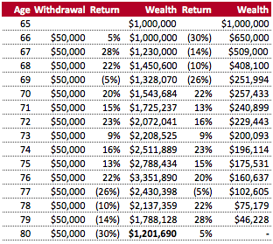
Impact of SORR
Sequence of return risk (SORR) refers to the risk an investor is exposed to due to possible changes in the order in which returns occur.
Assumptions:
Returns are same in all scenarios
Withdrawal is a fixed $ amount, not percentage of remaining balance
Distribution of wealth:
30% equity / 70% fixed income
Conclusion:
Sequence of returns matter
Bad returns in beginning over proportionately decrease wealth
SORR management paramount

Slide 6
SORR – A Short Introduction
Methodology
Utility Maximization with Static Glidepaths
Utility Maximization with Dynamic Glidepaths
Conclusion

Slide 7
steps to follow
1
Definition of SORR
2
Simulate Return Paths
3
Glidepaths (Static)
Glidepaths (Dynamic)
4
Maximize Utility Coverate Ratio (vs. Wealth)

Slide 8
Definition of SORR
To maximize our object function, we first need to define our SORR measure. SORR has no defined metric in the literature.
Bad return → wording change
$$SORR= \frac{\# Worst returns in first 10 years}{\# Total total bad returns }$$
Key Observations:
SORR ranges from 0 to 1
The higher SORR, the more bad returns accumulate in the beginning
Compounded return in first 10 years explains 77% of final retirement outcome⁽¹⁾
Notes: (1) Pfau, W. D. (2013), The Lifetime Sequence of Returns: A Retirement Planning Conundrum, p. 6.

Slide 9
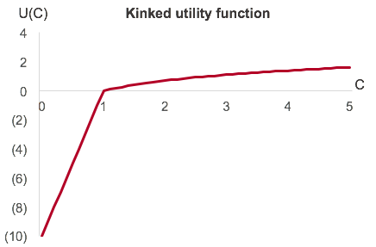
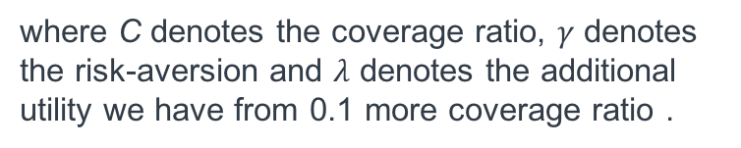
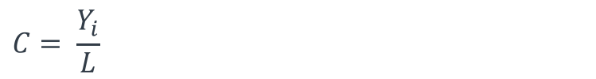
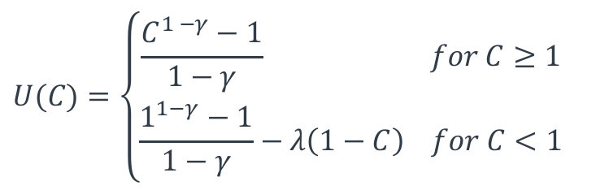
utility Coverage Ratio
Our maximization function is a kinked utility function. Our additional marginal utilitity is much higher if we do not fully cover our estimated lifetime.
(1)
$$U(C)=\left\{\begin{aligned}\frac{C^{1 −γ}−1}{1−γ} for C≥1 \\ \frac{1^{1−γ}−1}{1−γ}−λ\left(1−C\right) for C<1\end{aligned}\right.$$
where C denotes the coverage ratio, $γ$ denotes the risk-aversion and $λ$ denotes the additional utility we have from 0.1 more coverage ratio .
(1)
$$C= \frac{Y_{i}}{L}$$
where Y_{i} denotes the number of years covered by retirement plan and L denotes the number of years in retirement
Notes: (1) Based on Estrada, J. & Kritzman, M. (2018), Evaluating Retirement Strategies: A Utility-Based Approach. pp. 5-6.

Slide 10
SORR – A Short Introduction
Methodology
Utility Maximization with Static Glidepaths
Utility Maximization with Dynamic Glidepaths
Conclusion

Slide 11
Approach and Assumptions
Approach:
Define a current income level and a constant $ withdrawal
Define 3 different glidepaths (conservative, moderate, aggressive) and 3 different SORR exposure (bad returns early, random, late)
Using Monte Carlo simulation, detect distribution of coverage ratio and object function
Understand rationale, sensitivity and implications of observed data
Assumptions:
Choice of glidepath is static, i.e. once you choose a given asset allocation, you will not deviate from it no matter the market development⁽¹⁾
SORR is constant for projected period and can be observed ex ante
Monthly withdrawals are constant over time⁽²⁾
Discretization:
SORR: 0.3, 0.5, 0.7
Equity portion: 0.1, 0.3, 0.6
Notes: (1) Current market approach. (2) Monthly withdrawal as well as returns are inflation-adjusted.

Slide 12
Income level sensitivity
Equity portion = 0.1

Slide 13
Income level sensitivity
Equity portion = 0.3

Slide 14
Income level sensitivity
Equity portion = 0.6

Slide 15
Coverage ratio distribution
 |  | Glidepath
 |  | Conservative (Equity = 0.1) | Moderate (Equity = 0.3) | Aggressive (Equity = 0.6)
Timing bad return | Early (SORR = 0.3)
 | Random (SORR = 0.5)
 | Late (SORR = 0.7)

Slide 16
utility Coverage ratio
 |  | Glidepath
 |  | Conservative (Equity = 0.1) | Moderate (Equity = 0.3) | Aggressive (Equity = 0.6)
Timing bad return | Early (SORR = 0.3)
 | Random (SORR = 0.5)
 | Late (SORR = 0.7)

Slide 17
SORR – A Short Introduction
Methodology
Utility Maximization with Static Glidepaths
Utility Maximization with Dynamic Glidepaths
Conclusion

Slide 18
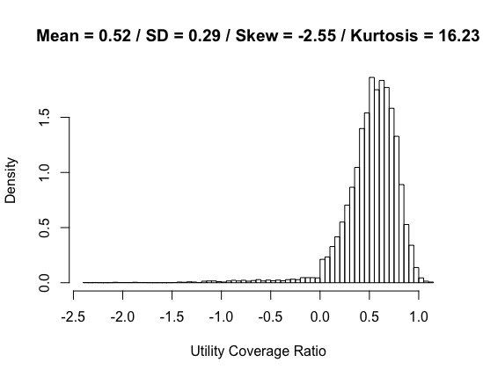
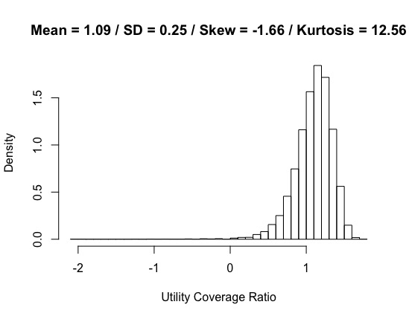
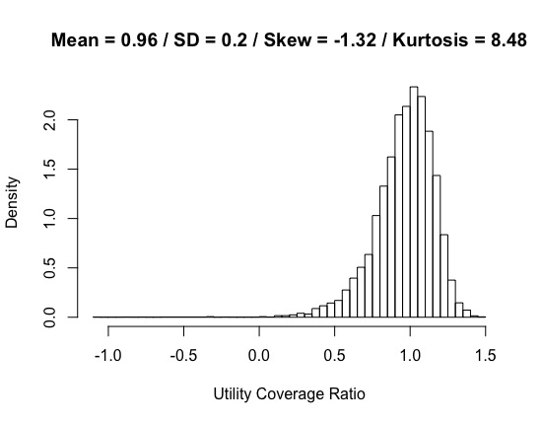
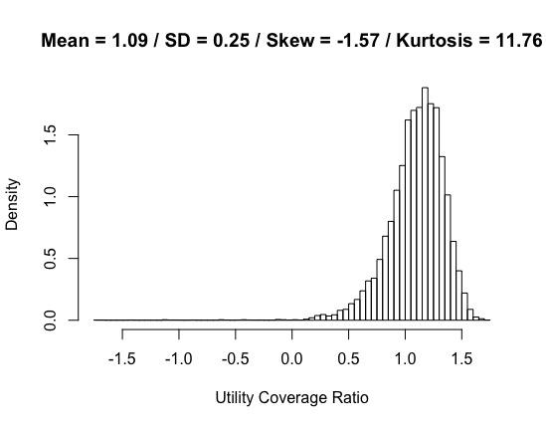
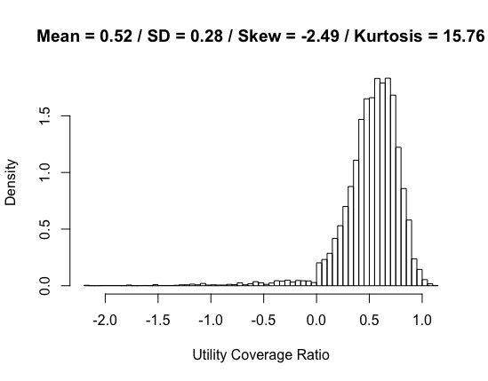
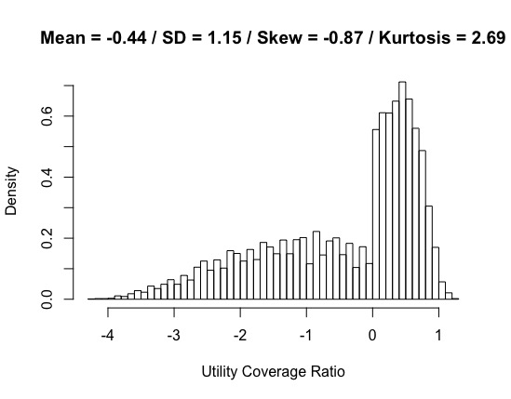
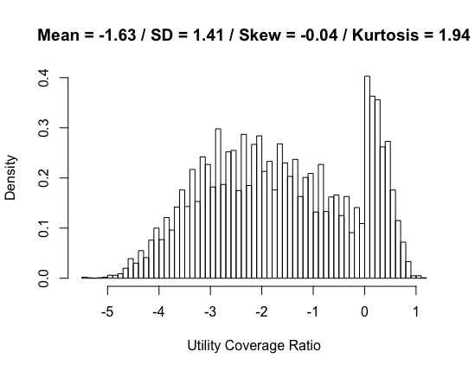
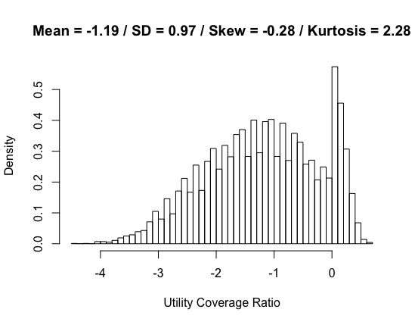
Semi-dynamic strategies
 |  | Glidepath
 |  | Equity from 0.3 to 0.6 | Equity from 0.6 to 0.3 | 100 – Age
Timing bad return | Early (SORR = 0.3)
 | Random (SORR = 0.5)
 | Late (SORR = 0.7)

Slide 19
Mean-reversion & Momentum
 |  | Glidepath
 |  | Equity from 0.3 to 0.6 | Equity from 0.6 to 0.3 | 100 – Age
Timing bad return | Early (SORR = 0.3)
 | Random (SORR = 0.5)
 | Late (SORR = 0.7)

Slide 20
Constant proportion Portfolio Insurance (CPPI)
 |  | Glidepath
 |  | Equity from 0.3 to 0.6 | Equity from 0.6 to 0.3 | 100 – Age
Timing bad return | Early (SORR = 0.3)
 | Random (SORR = 0.5)
 | Late (SORR = 0.7)

Slide 21
SORR – A Short Introduction
Methodology
Utility Maximization with Static Glidepaths
Utility Maximization with Dynamic Glidepaths
Conclusion

Slide 22
Strategy Summary
SORR = 0.3
Utility Coverage Ratio | Mean | St. Dev. | Skewness | Kurtosis
Constant Equity 0.1 | 0.79 | 0.15 | -0.84 | 4.55
Constant Equity 0.3 | 1.37 | 0.09 | -0.44 | 3.28
Constant Equity 0.6 | 1.98 | 0.07 | -0.46 | 3.49
100 - Age | 0.58 | 8.71 | 1.03 | 2.91
Equity 0.3 to 0.6 | 1.90 | 0.08 | -0.29 | 3.25
Equity 0.6 to 0.3 | 2.43 | 0.09 | -0.19 | 3.14
Mean-reversion
Momentum
CPPI | 1.26 | 0.07 | -0.35 | 3.37

Slide 23
Strategy Summary
SORR = 0.5
Utility Coverage Ratio | Mean | St. Dev. | Skewness | Kurtosis
Constant Equity 0.1 | 0.56 | 0.26 | -2.32 | 14.80
Constant Equity 0.3 | 1.48 | 0.13 | -0.68 | 3.96
Constant Equity 0.6 | 2.32 | 0.11 | -0.65 | 3.89
100 - Age | -2.41 | 6.42 | 1.50 | 4.47
Equity 0.3 to 0.6 | 1.85 | 0.12 | -0.55 | 3.68
Equity 0.6 to 0.3 | 1.97 | 0.15 | -0.55 | 3.67
Mean-reversion
Momentum
CPPI | 1.05 | 0.10 | -0.48 | 3.47

Slide 24
Strategy Summary
SORR = 0.7
Utility Coverage Ratio | Mean | St. Dev. | Skewness | Kurtosis
Constant Equity 0.1 | -0.57 | 0.36 | -2.79 | 16.38
Constant Equity 0.3 | 1.03 | 0.30 | -2.82 | 23.17
Constant Equity 0.6 | 1.61 | 0.45 | -3.66 | 29.22
100 - Age | -1.19 | 0.97 | -0.28 | 2.28
Equity 0.3 to 0.6 | 1.56 | 0.27 | -1.76 | 12.56
Equity 0.6 to 0.3 | 1.08 | 0.50 | -3.24 | 20.88
Mean-reversion
Momentum
CPPI | 0.79 | 0.15 | -0.93 | 5.63

Slide 25
Closing remarks

Slide 26
Thank you

